Slide 1

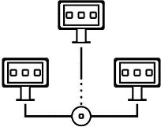



Introduction to
Parallel and Distributed Programming
CS4
Introduction to MPI
Sachin D N

Slide 2
Agenda
Setting up a cluster of VMs
Message Passing Interface
Blocking / Non-blocking messages
Data partitioning
Lab2: Parallel and distributed data processing

Slide 3

Lab 2: Use cluster to distribute work and do some
parallel data processing
Now that you have a group of nodes managed as a cluster
Create a distributed data processing capability.
Master node takes a dataset and distributes / partitions the data on multiple active slaves that have
enough resources.
Slaves process the data and send results back to Master. Master merges / reduces the data and reports back to the user.
Use blocking vs non-blocking messages in OpenMPI.
Status of the work at slaves is reported back to the master as work progresses and finishes.
Master collects the performance data (CPU, mem, IO) and stores it for analysis.
Any errors are also reported to the master.
Use compression to transfer data. Quantify communication cost - bytes sent over the network,
latency of transfer.
Use OpenMPI for communication between nodes, zlib etc. compression libs
Handle a node crash - Master should get work done on remaining nodes. What are the options - should it restart the job or only shift part of the work to another node ? How is a slave crash detected
? Use the heartbeat mechanism.

Slide 4













Last session

Slide 5
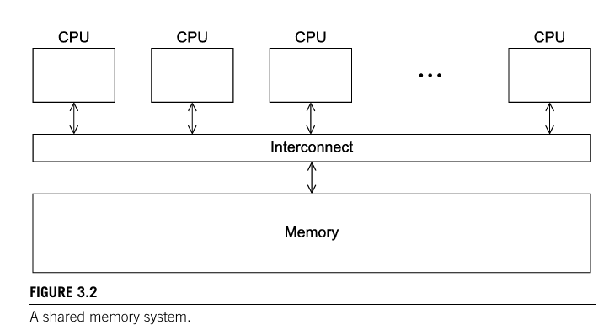
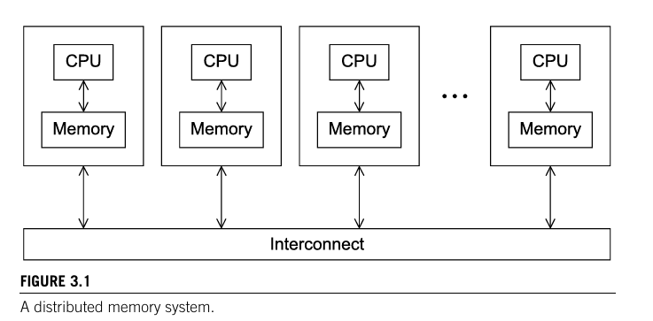
Shared vs Distributed Memory

Slide 6
Message Passing with MPI
What is MPI?
MPI (Message-Passing Interface) is a standardized library for message-passing in distributed-memory systems. It is not a new programming language but a collection of functions that can be used in C and Fortran.
Key Features of MPI
Allows inter-process communication in distributed-memory systems.
Scalable for running on hundreds or thousands of processes.
Portable and works across different HPC (High-Performance Computing) clusters.
Supports synchronous (blocking) and asynchronous (non-blocking) communication.

Slide 7
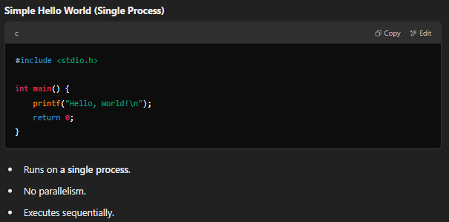
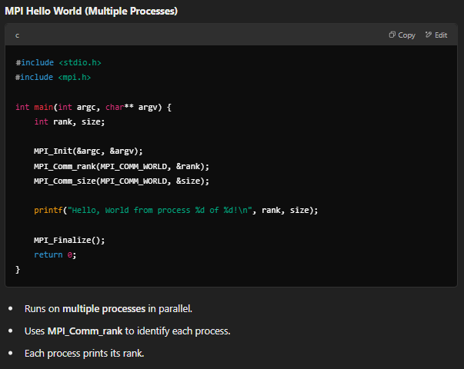
mpicc -o mpi_hello mpi_hello.c
mpiexec -n 4 ./mpi_hello

Slide 8
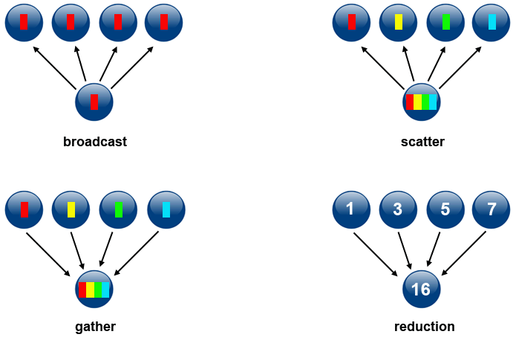
Using OpenMPI to Implement the Communication Layer
3.1 Key OpenMPI Communication Functions
Point-to-Point Communication
MPI_Send and MPI_Recv for blocking communication.
MPI_Isend and MPI_Irecv for non-blocking communication.
Collective Communication
MPI_Bcast for broadcasting data.
MPI_Scatter and MPI_Gather for distributing and collecting data across processes.

Slide 9
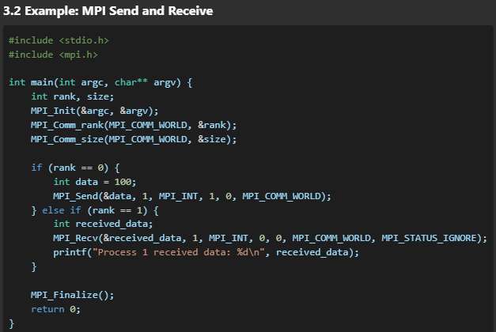

Slide 10
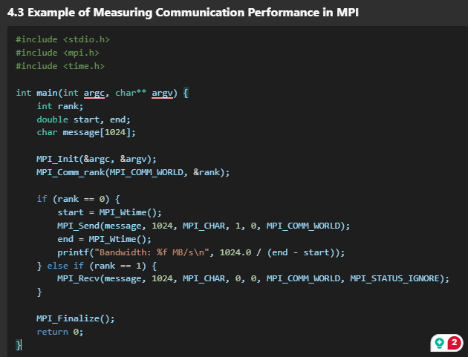
Communication Cost - Bandwidth, Latency, and Payload Size
Key Metrics in Communication Cost
Bandwidth (Throughput): The amount of data transferred per unit time (measured in MB/s or GB/s).
Latency: The time taken to initiate and complete a data transfer (measured in milliseconds or microseconds).
Payload Size: The amount of data being transferred in a single message.
4.2 Formula for Bandwidth Calculation
Bandwidth = Payload Size / Transfer Time

Slide 11
What is Throttling / Flow Control and Where is it Useful?
Definition of Throttling
Throttling refers to regulating data transmission rates to prevent network congestion.
Why is Throttling Important?
Prevents overwhelming the receiver with excessive data.
Ensures fair bandwidth distribution.
Reduces packet loss and retransmissions.
Payload Compression to Reduce Size at Increased Processing Cost
Why Use Compression?
Reduces data transfer size.
Increases efficiency when bandwidth is limited.
Requires additional CPU processing for decompression.

Slide 12
Safety in MPI programs, Deadlock?
The MPI standard allows MPI_Send to behave in two different ways:
it can simply copy the message into an MPI managed buffer and return,
or it can block until the matching call to MPI_Recv starts.

Slide 13
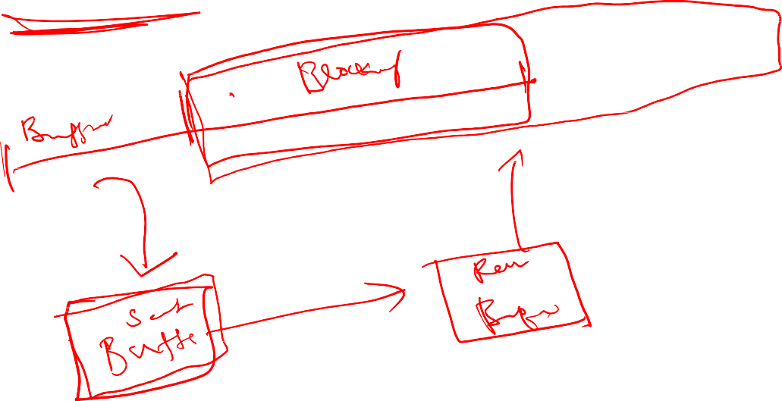

Safety in MPI programs
Many implementations of MPI set a threshold at which the system switches
from buffering to blocking.
Relatively small messages will be buffered by MPI_Send.
Larger messages, will cause it to block.

Slide 14



Safety in MPI programs
If the MPI_Send is executed by each process block, no process will be able to start executing a call to MPI_Recv, and the program will hang or deadlock.
Each process is blocked, waiting for an event that will never happen.
(see pseudo-code)

Slide 15
Safety in MPI programs
A program that relies on MPI provided buffering is said to be unsafe.
Such a program may run without problems for various sets of input, but it may hang or crash with other sets.

Slide 16
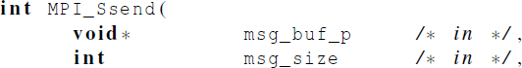
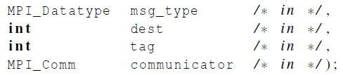
MPI_Ssend
An alternative to MPI_Send defined by the MPI standard.
The extra “s” stands for synchronous and MPI_Ssend is guaranteed to
block until the matching receive starts.

Slide 17
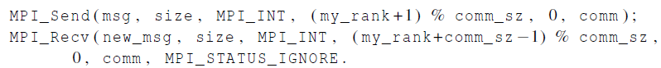




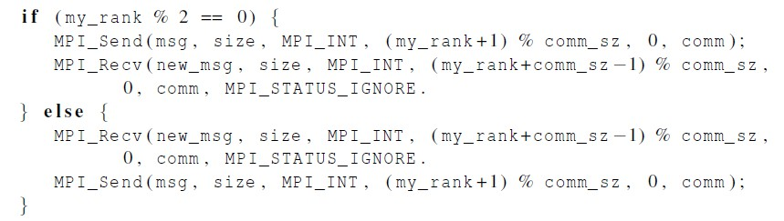
Restructuring communication

Slide 18
MPI_Sendrecv
An alternative to scheduling the communications ourselves.
Carries out a blocking send and a receive in a single call.
The dest and the source can be the same or different.
Especially useful because MPI schedules the communications so that the program won’t hang or crash.

Slide 19


















Safe communication with five processes

Slide 20
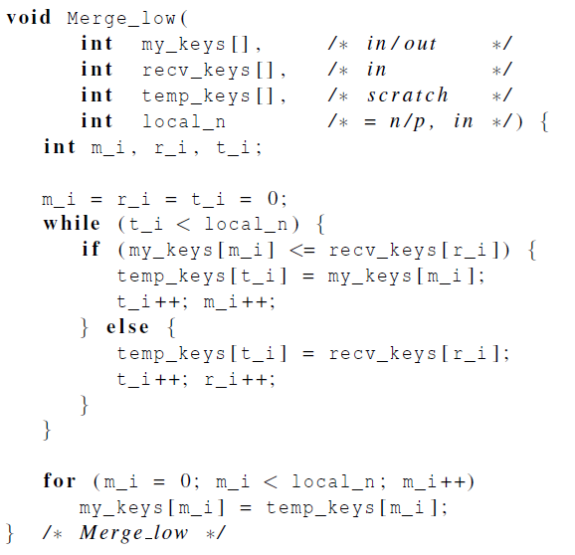
Parallel odd-even transposition sort

Slide 21
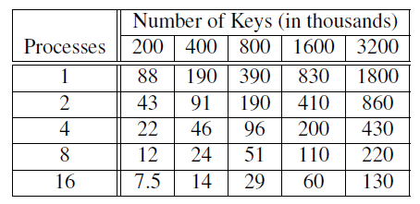
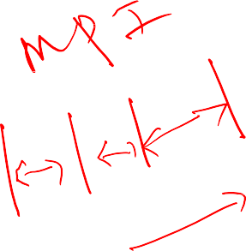

Run-times of parallel odd-even sort
(times are in milliseconds)

Slide 22
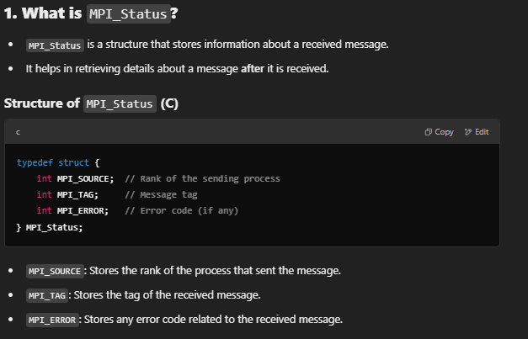
status_p argument
status_p → Pointer to an MPI_Status object storing message details.
MPI_Status* status;
status.MPI_SOURCE status.MPI_TAG
status_p (or MPI_Status) stores metadata about received messages.
It is critical when handling messages from multiple sources or with different tags.
If message details aren’t needed, use MPI_STATUS_IGNORE to optimize performance.
Use MPI_Get_count to determine actual message size.

Slide 23
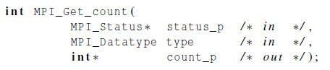

How much data am I receiving?

Slide 24

Issues with send and receive
Exact behavior is determined by the MPI implementation.
MPI_Send may behave differently with regard to buffer size, cutoffs and
blocking.
MPI_Recv always blocks until a matching message is received.
Know your implementation;
don’t make assumptions!

Slide 25
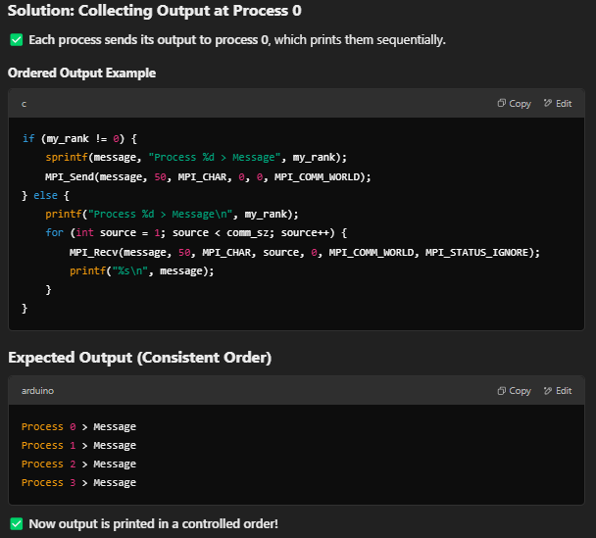
Handling Output in MPI
Problem: Random Order of Printed Messages
Multiple MPI processes compete for stdout, causing unpredictable output order.
Example output (random order on each run):
Process 0 > Message, Process 3 > Message, Process 1 > Message, Process 2 > Message

Slide 26
Input
Problem: Only Rank 0 Can Read User Input
MPI implementations restrict stdin access to process 0.
Other processes do not receive user input automatically.
Solution: Rank 0 Reads Input & Distributes It
✅ Process 0 reads input and sends it to all processes using MPI_Send.
✅ More Efficient Alternative: Using MPI_Bcast
Issue | Solution
Only Rank 0 Can Read Input | Rank 0 distributes input using MPI_Send or MPI_Bcast
Random Output Order | Process 0 collects and prints messages

Slide 27
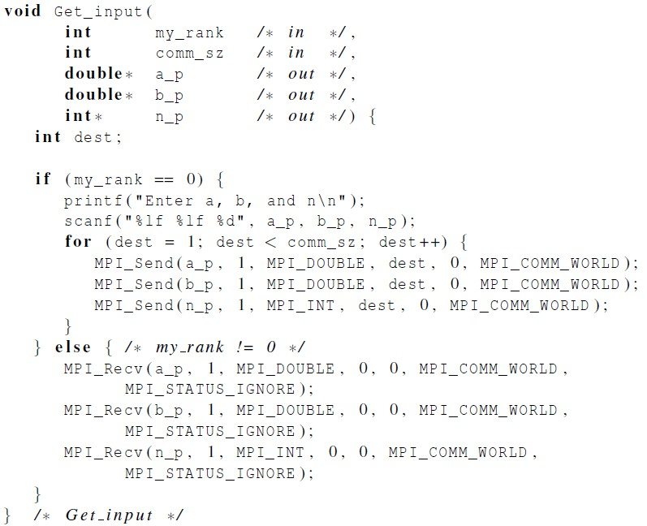
Function for reading user input

Slide 28
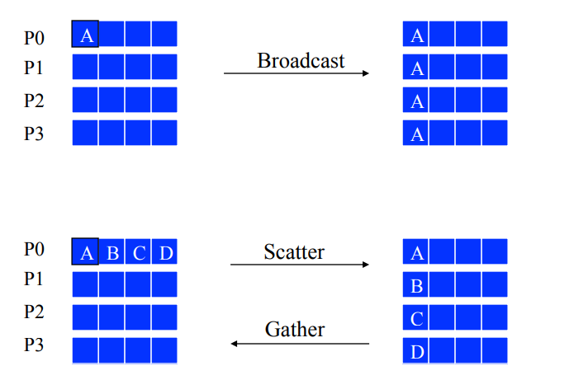

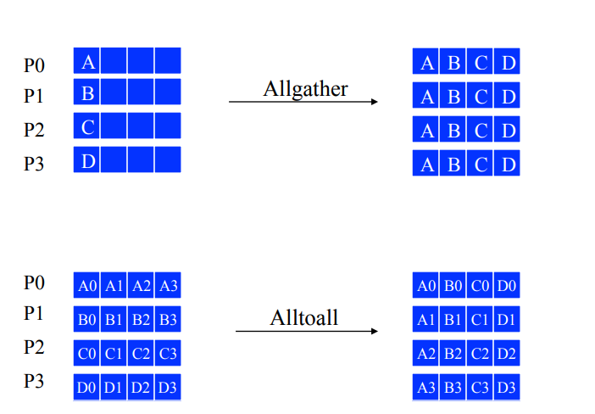
Collective communication

Slide 29
Tree-structured communication
In the first phase:
Process 1 sends to 0, 3 sends to 2, 5 sends to 4, and 7 sends to 6.
Processes 0, 2, 4, and 6 add in the received values.
Processes 2 and 6 send their new values to processes 0 and 4, respectively.
Processes 0 and 4 add the received values into their new values.
(a) Process 4 sends its newest value to process 0.
(b) Process 0 adds the received value to its newest value.

Slide 30

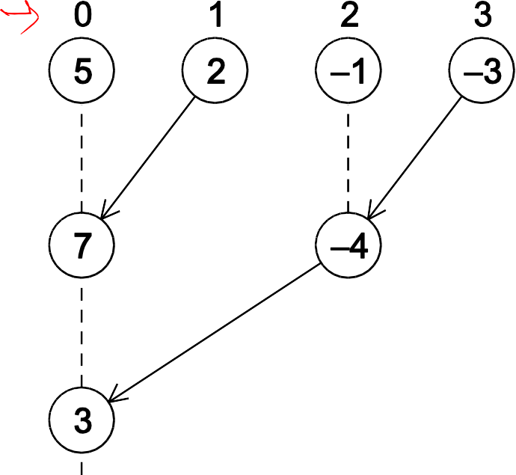
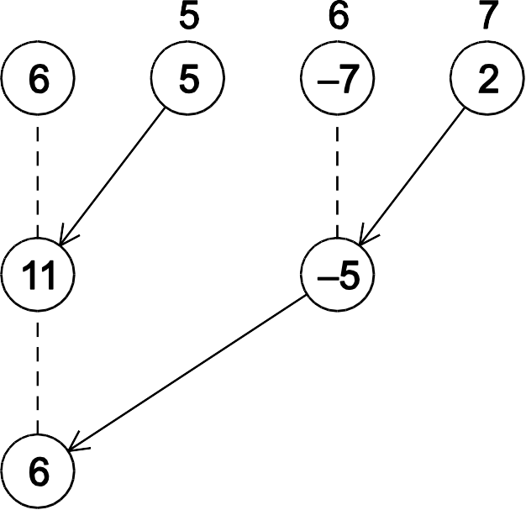



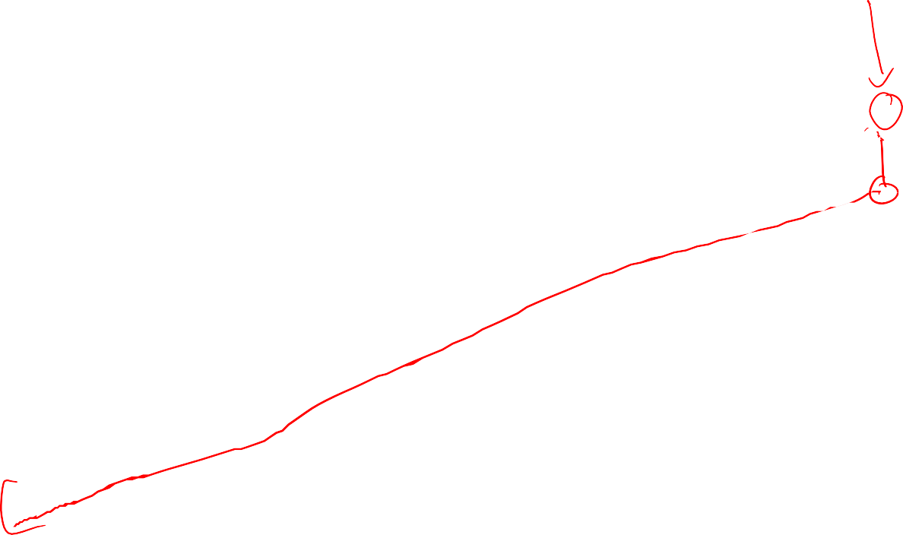
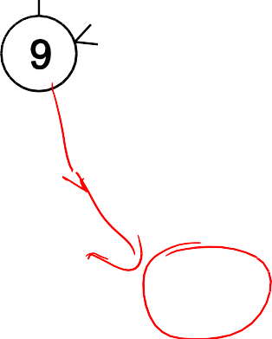
A tree-structured global sum

Slide 31










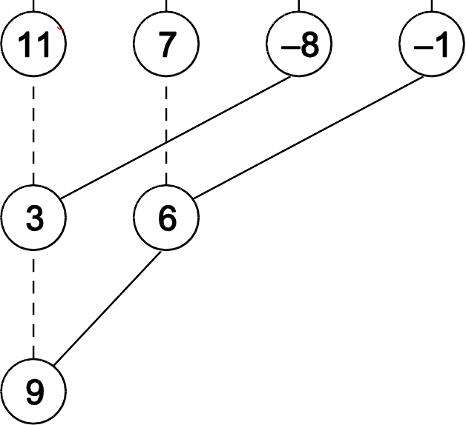
An alternative tree-structured global sum

Slide 32
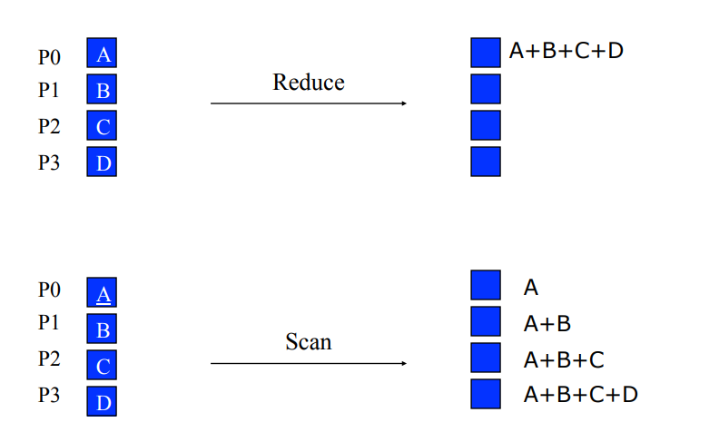
Collective Computation

Slide 33
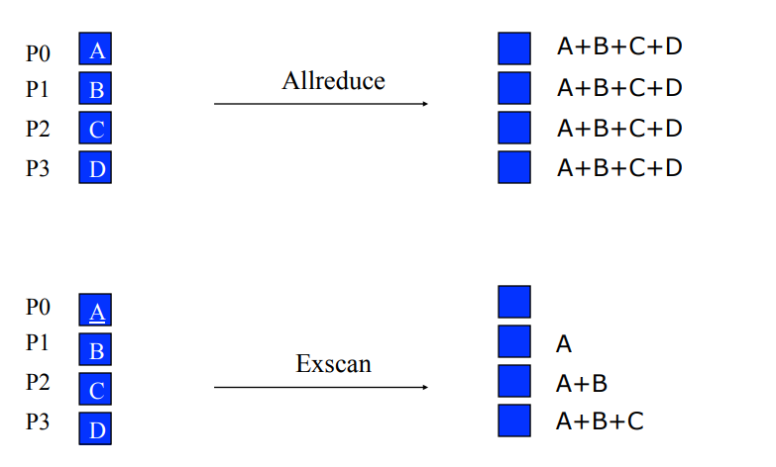
Collective Computation

Slide 34
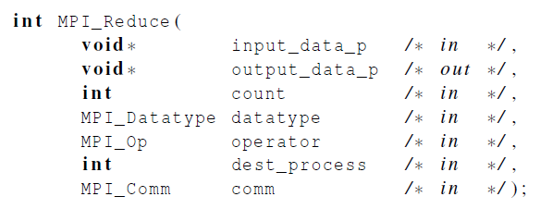
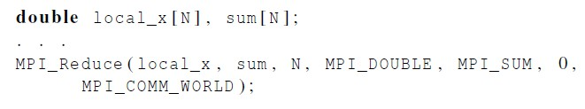
MPI_Reduce

Slide 35
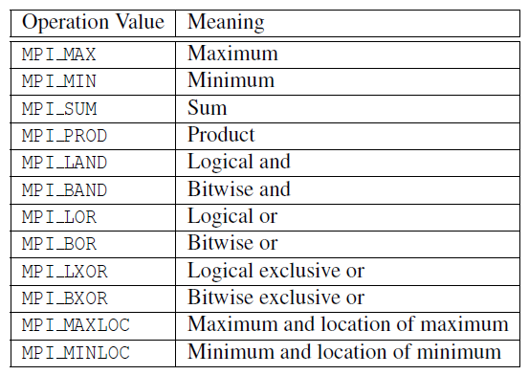
Predefined reduction operators in MPI

Slide 36
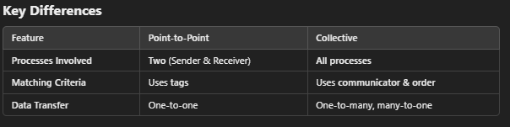
Collective vs. Point-to-Point Communications
Point-to-Point Communication
✅ Direct communication between two processes ✅ Uses tags to match messages ✅ Functions: MPI_Send, MPI_Recv
Example (Process 0 sends data to Process 1):
Collective Communication
✅ Involves all processes in a communicator ✅ No tags—all processes must call the function ✅ Functions: MPI_Bcast, MPI_Reduce, MPI_Gather, MPI_Scatter
Example (MPI_Bcast: Process 0 shares data with all processes):

Slide 37
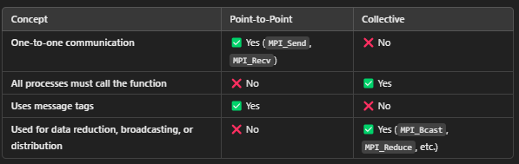
Collective vs. Point-to-Point Communications
Best Practices for Collective Communication
✅ All processes must call the same collective function ✅ Arguments must be compatible (same destination rank) ✅ Avoid using the same buffer for input & output
❌ Wrong: Using the same buffer in MPI_Reduce
Use Case : Distributing an Array (MPI_Scatter)
✅ Process 0 distributes elements of array to all processes.

Slide 38
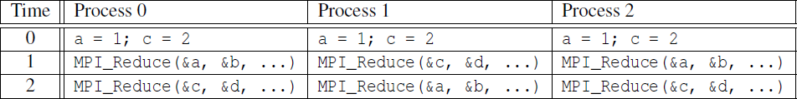
Example (1)
Multiple calls to MPI_Reduce
Use Case: Summing Values from All Processes (MPI_Reduce)
✅ Each process contributes its value, and process 0 prints the total sum.

Slide 39
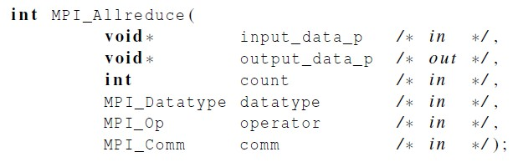
MPI_Allreduce
Useful in a situation in which all of the processes need the result of a global sum in order to complete some larger computation.

Slide 40


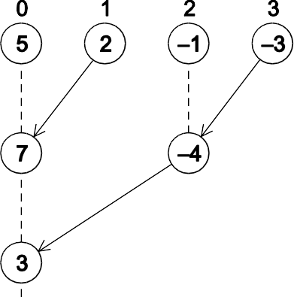




















A global sum followed by distribution of the result.

Slide 41

A butterfly-structured global sum.

Slide 42
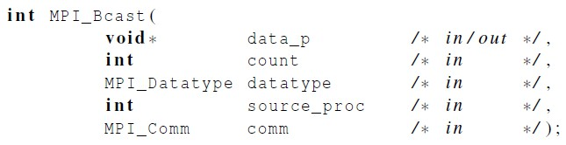
Broadcast
Data belonging to a single process is sent to all of the processes in the communicator.

Slide 43















A tree-structured broadcast.

Slide 44
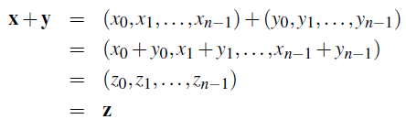



Data distributions
Compute a vector sum.

Slide 45
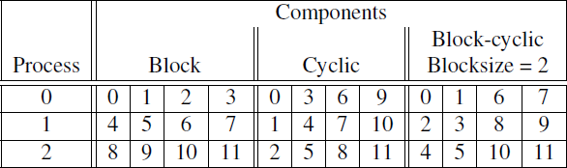
Different partitions of a 12-component vector among 3
processes

Slide 46
Partitioning options
Block partitioning
Assign blocks of consecutive components to each process.
Cyclic partitioning
Assign components in a round robin fashion.
Block-cyclic partitioning
Use a cyclic distribution of blocks of components.

Slide 47
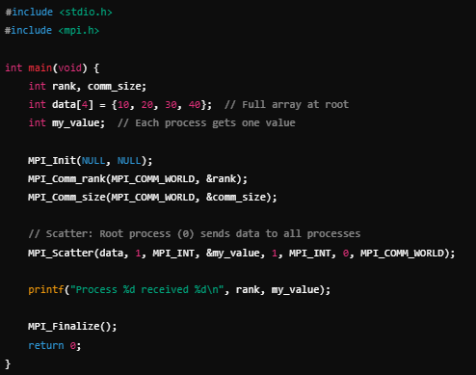
Scatter
What is MPI_Scatter?
✅ Distributes an array from one process (root) to all processes in communicator ✅ Each process gets a unique portion of the data ✅ Root process (Rank 0) holds the full array and splits it

Slide 48
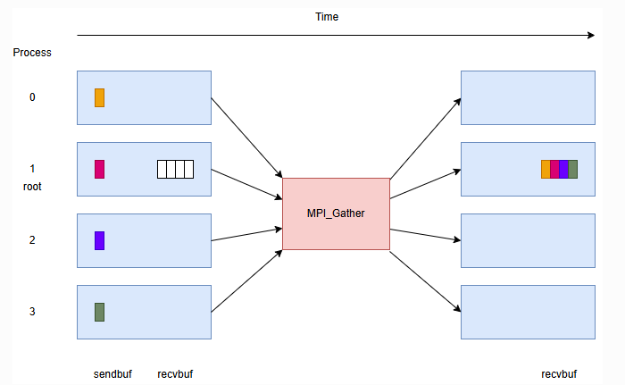
Gather
What is MPI_Gather?
✅ Collects data from all processes and sends it to a single root process ✅ Each process contributes a portion of the data ✅ Root process (Rank 0) gathers all values into a single array
https://enccs.github.io/intermediate-mpi/collective-communication-pt2/

Slide 49
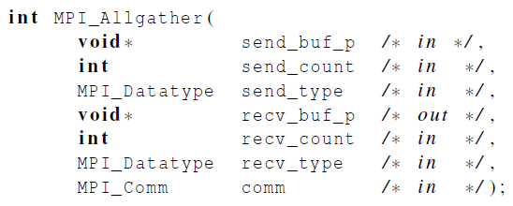
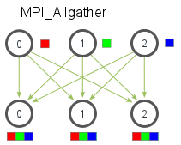
Allgather
Concatenates the contents of each process’ send_buf_p and stores this in each process’ recv_buf_p.
As usual, recv_count is the amount of data being received from each process.

Slide 50
Matrix-vector multiplication
i-th component of y
Dot product of the ith
row of A with x.

Slide 51




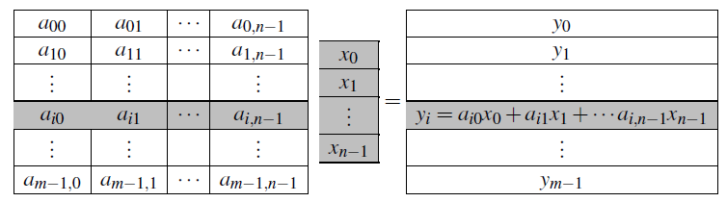













Matrix-vector multiplication

Slide 52
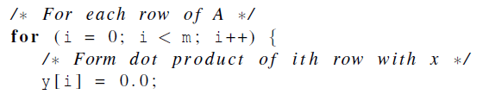
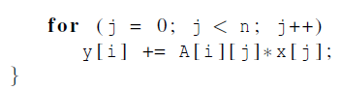
Multiply a matrix by a vector
Serial pseudo-code

Slide 53
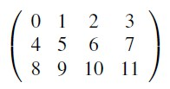
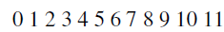
C style arrays
stored as

Slide 54
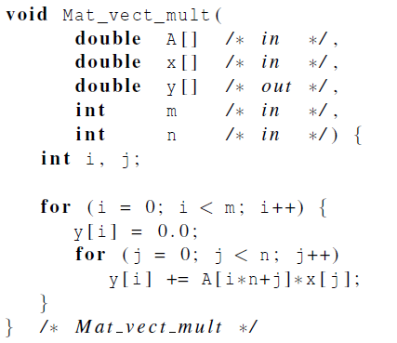
Serial matrix-vector multiplication

Slide 55

An MPI matrix-vector multiplication function (1)

Slide 56



An MPI matrix-vector multiplication function (2)

Slide 57

Mpi derived datatypes

Slide 58
Derived datatypes
When sending and receiving messages in MPI (Message Passing Interface), we usually use basic datatypes like MPI_INT, MPI_FLOAT, or MPI_CHAR. But what if we want to send custom structures like a struct in C? This is where derived MPI datatypes come into play.
Used to represent any collection of data items in memory by storing both the types of the items and their relative locations in memory.
The idea is that if a function that sends data knows this information about a collection of data items, it can collect the items from memory before they are sent.
Similarly, a function that receives data can distribute the items into their correct destinations in memory when they’re received.

Slide 59


Slide 60
Derived datatypes
Formally, consists of a sequence of basic MPI data types together with a displacement for each of the data types.
Creating an MPI Derived Datatype
To properly send and receive a Pair struct, we define a custom MPI
datatype.
Step 1: Define the Structure
c
struct Pair
{
int first; // 4 bytes
char second; // 1 byte (might have padding)
};

Slide 61

MPI_Type create_struct
Builds a derived datatype that consists of individual elements that have different basic types.

Slide 62

Received: 42, A

Slide 63
How This Works
MPI_Get_address() is used to find memory locations of first and second.
MPI_Type_create_struct() creates the derived datatype based on:
Number of elements in each field (block lengths).
Memory displacements to handle padding.
MPI base types (MPI_INT, MPI_CHAR).
MPI_Send() / MPI_Recv() now work with the custom datatype.

Slide 64

Performance evaluation
https://github.com/sachugowda/pds-bits/blob/main/CS4/06_performance.md

Slide 65





Elapsed parallel time
Returns the number of seconds that have elapsed since some time in the past.

Slide 66







Elapsed serial time
In this case, you don’t need to link in the MPI libraries.
Returns time in microseconds elapsed from some point in the past.

Slide 67

Elapsed serial time

Slide 68

MPI_Barrier
Ensures that no process will return from calling it until every process in the communicator has started calling it.

Slide 69


MPI_Barrier

Slide 70


Run-times of serial and parallel matrix-vector multiplication
(Seconds)

Slide 71


Speedup

Slide 72

Efficiency

Slide 73

Speedups of Parallel Matrix-Vector Multiplication

Slide 74

Efficiencies of Parallel Matrix-Vector Multiplication

Slide 75








Scalability
A program is scalable if the problem size can be increased at a rate so that the efficiency doesn’t decrease as the number of processes increase.

Slide 76








Scalability
Programs that can maintain a constant efficiency without increasing the problem size are sometimes said to be strongly scalable.
Programs that can maintain a constant efficiency if the problem size increases at the same rate as the number of processes are sometimes said to be weakly scalable.

Slide 77
A parallel sorting algorithm

Slide 78




Sorting
n keys and p = comm sz processes.
n/p keys assigned to each process.
No restrictions on which keys are assigned to which processes.
When the algorithm terminates:
The keys assigned to each process should be sorted in (say) increasing order.
If 0 ≤ q < r < p, then each key assigned to process q should be less than or equal to every key assigned to process r.

Slide 79


Serial bubble sort

Slide 80
Odd-even transposition sort
A sequence of phases.
Even phases, compare swaps:
Odd phases, compare swaps:

Slide 81
Example
Start: 5, 9, 4, 3
Even phase: compare-swap (5,9) and (4,3)
getting the list 5, 9, 3, 4
Odd phase: compare-swap (9,3) getting the list 5, 3, 9, 4
Even phase: compare-swap (5,3) and (9,4)
getting the list 3, 5, 4, 9
Odd phase: compare-swap (5,4)
getting the list 3, 4, 5, 9

Slide 82




Serial odd-even transposition sort

Slide 83


Communications among tasks in odd-even sort
Tasks determining a[i] are labeled with a[i].

Slide 84


Parallel odd-even transposition sort

Slide 85

Pseudo-code

Slide 86

Compute_partner

Slide 87
Parallel odd-even transposition sort

Slide 88
Run-times of parallel odd-even sort
(times are in milliseconds)

Slide 89

Concluding Remarks (1)
MPI or the Message-Passing Interface is a library of functions that can be
called from C, C++, or Fortran programs.
A communicator is a collection of processes that can send messages to each other.
Many parallel programs use the single-program multiple data or SPMD approach.

Slide 90



Concluding Remarks (2)
Most serial programs are deterministic: if we run the same program with
the same input we’ll get the same output.
Parallel programs often don’t possess this property.
Collective communications involve all the processes in a communicator.

Slide 91
Concluding Remarks (3)
When we time parallel programs, we’re usually interested in elapsed time
or “wall clock time”.
Speedup is the ratio of the serial run-time to the parallel run-time.
Efficiency is the speedup divided by the number of parallel processes.

Slide 92

Concluding Remarks (4)
If it’s possible to increase the problem size (n) so that the efficiency doesn’t decrease as p is increased, a parallel program is said to be scalable.
An MPI program is unsafe if its correct behavior depends on the fact that MPI_Send is buffering its input.

